Slide 1
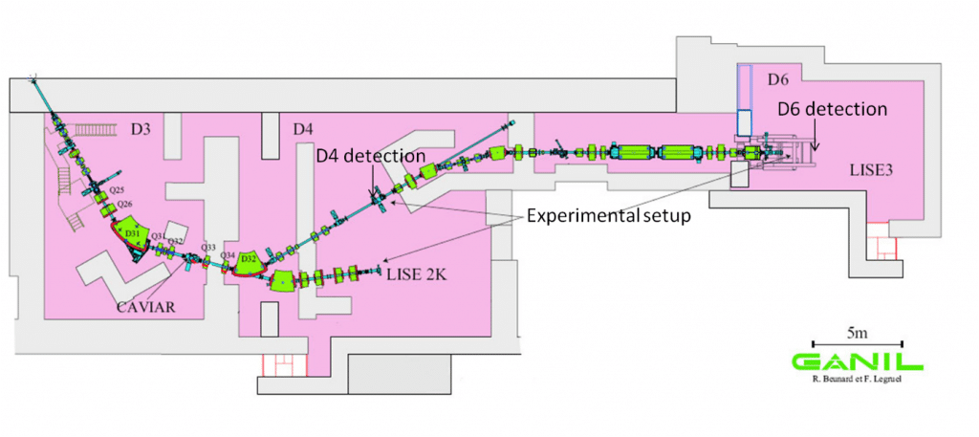
Production of ⁴²Ti with LISE Spectrometer

Slide 2
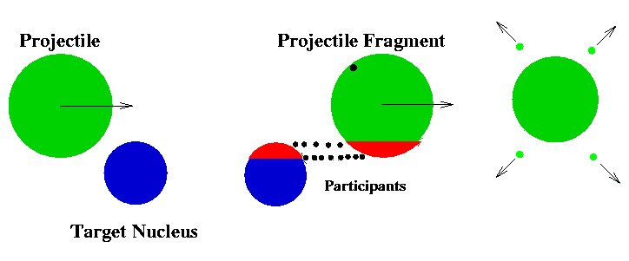
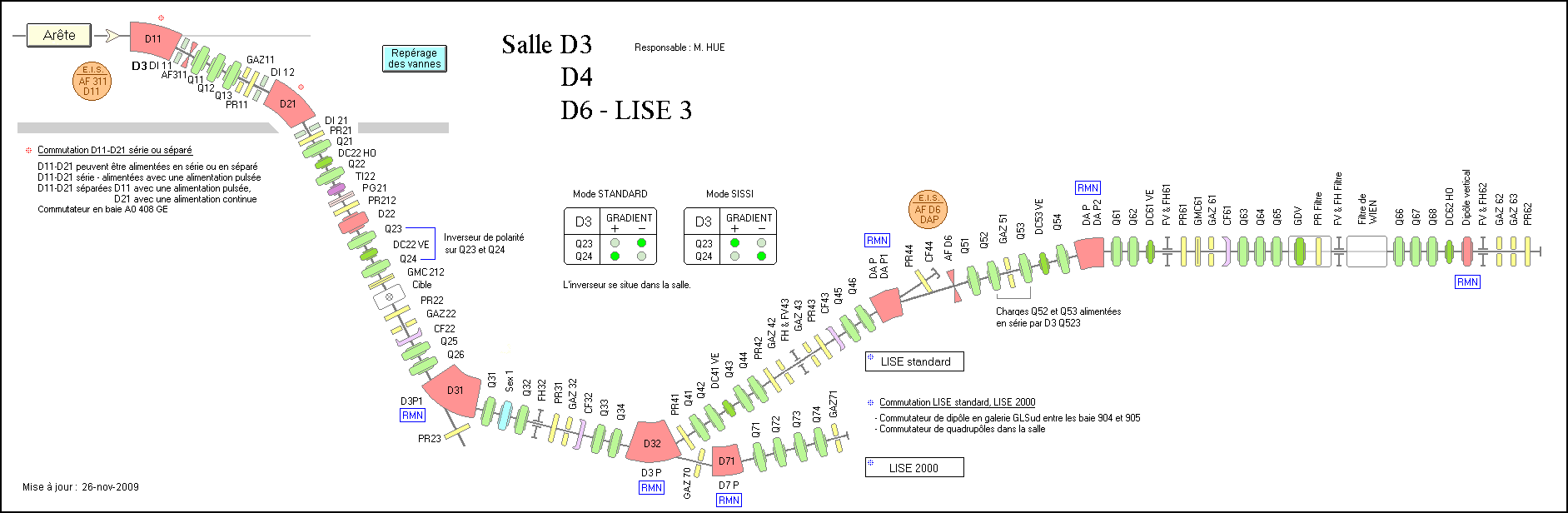
Lise Spectrometer
⁴⁶Ti
Components:
Target
Magnetic Dipoles & Quadrupoles
Slits
Wedge
Wein Filter
Detectors
Target
Slits
43
Slits
31
Wien filter
DP2
Slits
62
DP1
SiD4
560 µm Be degrader

Slide 3
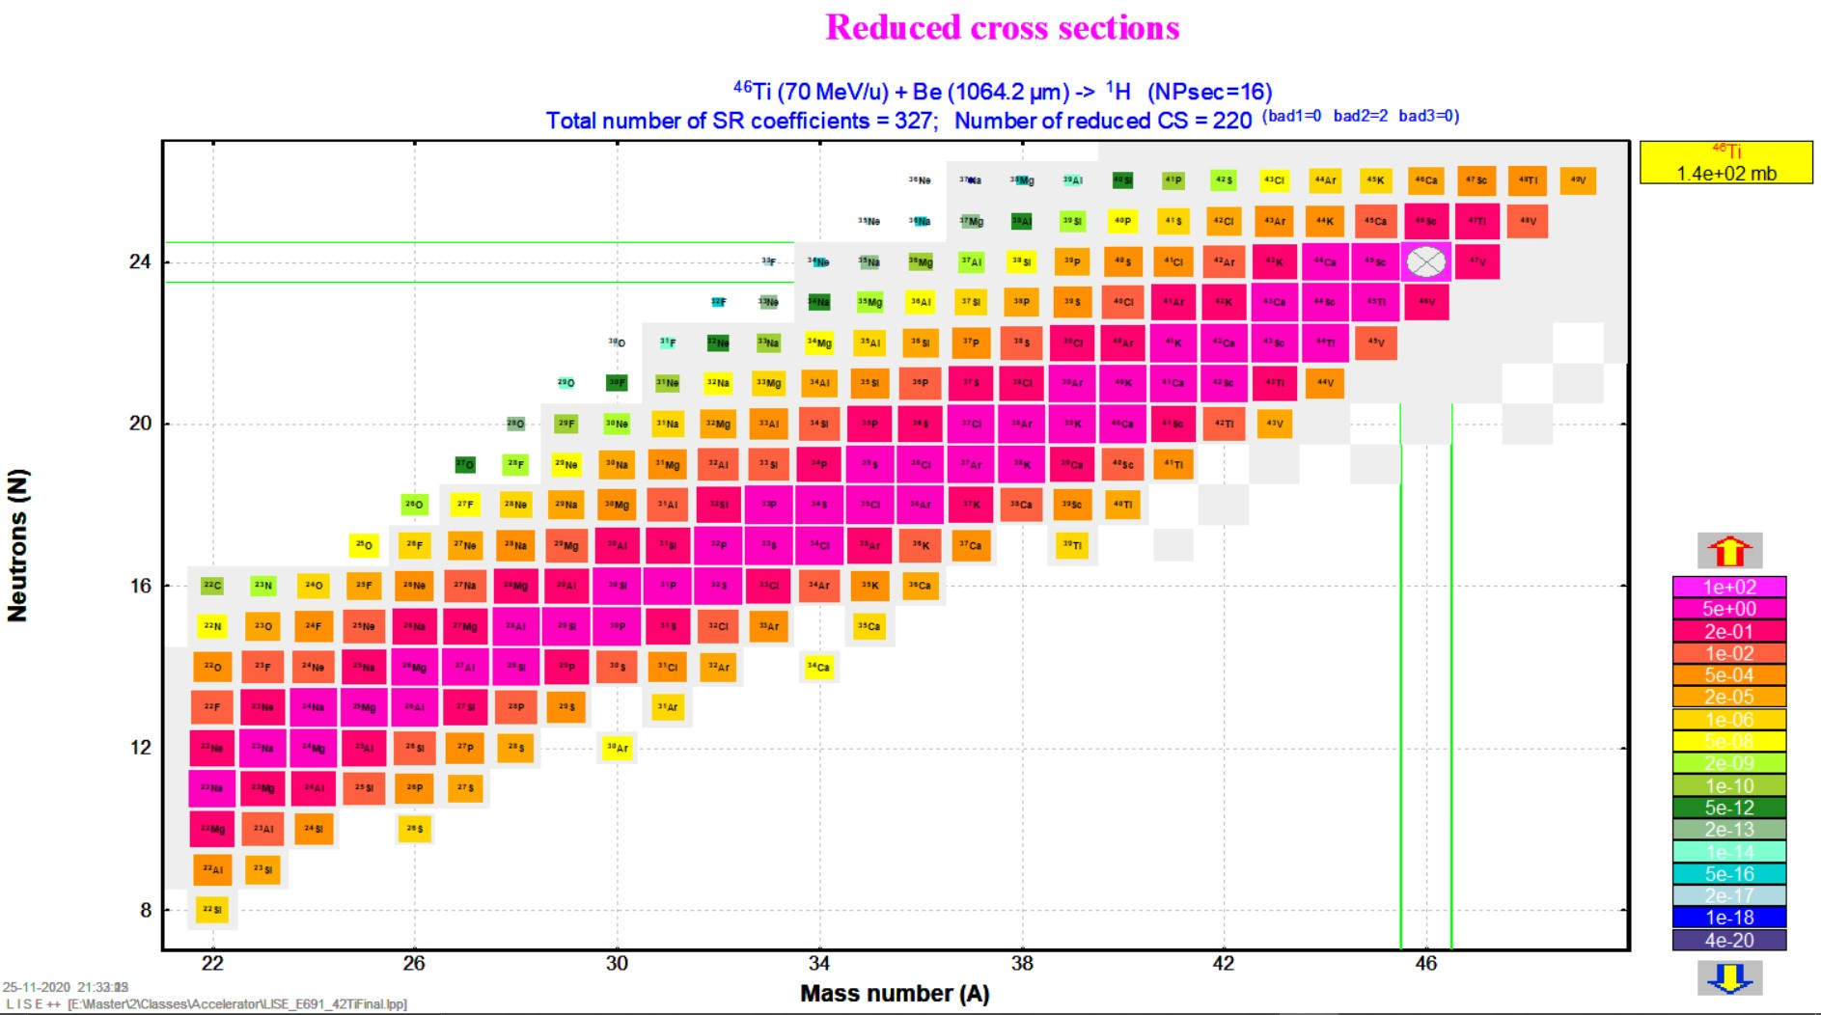
Choice of Projectile

Slide 4
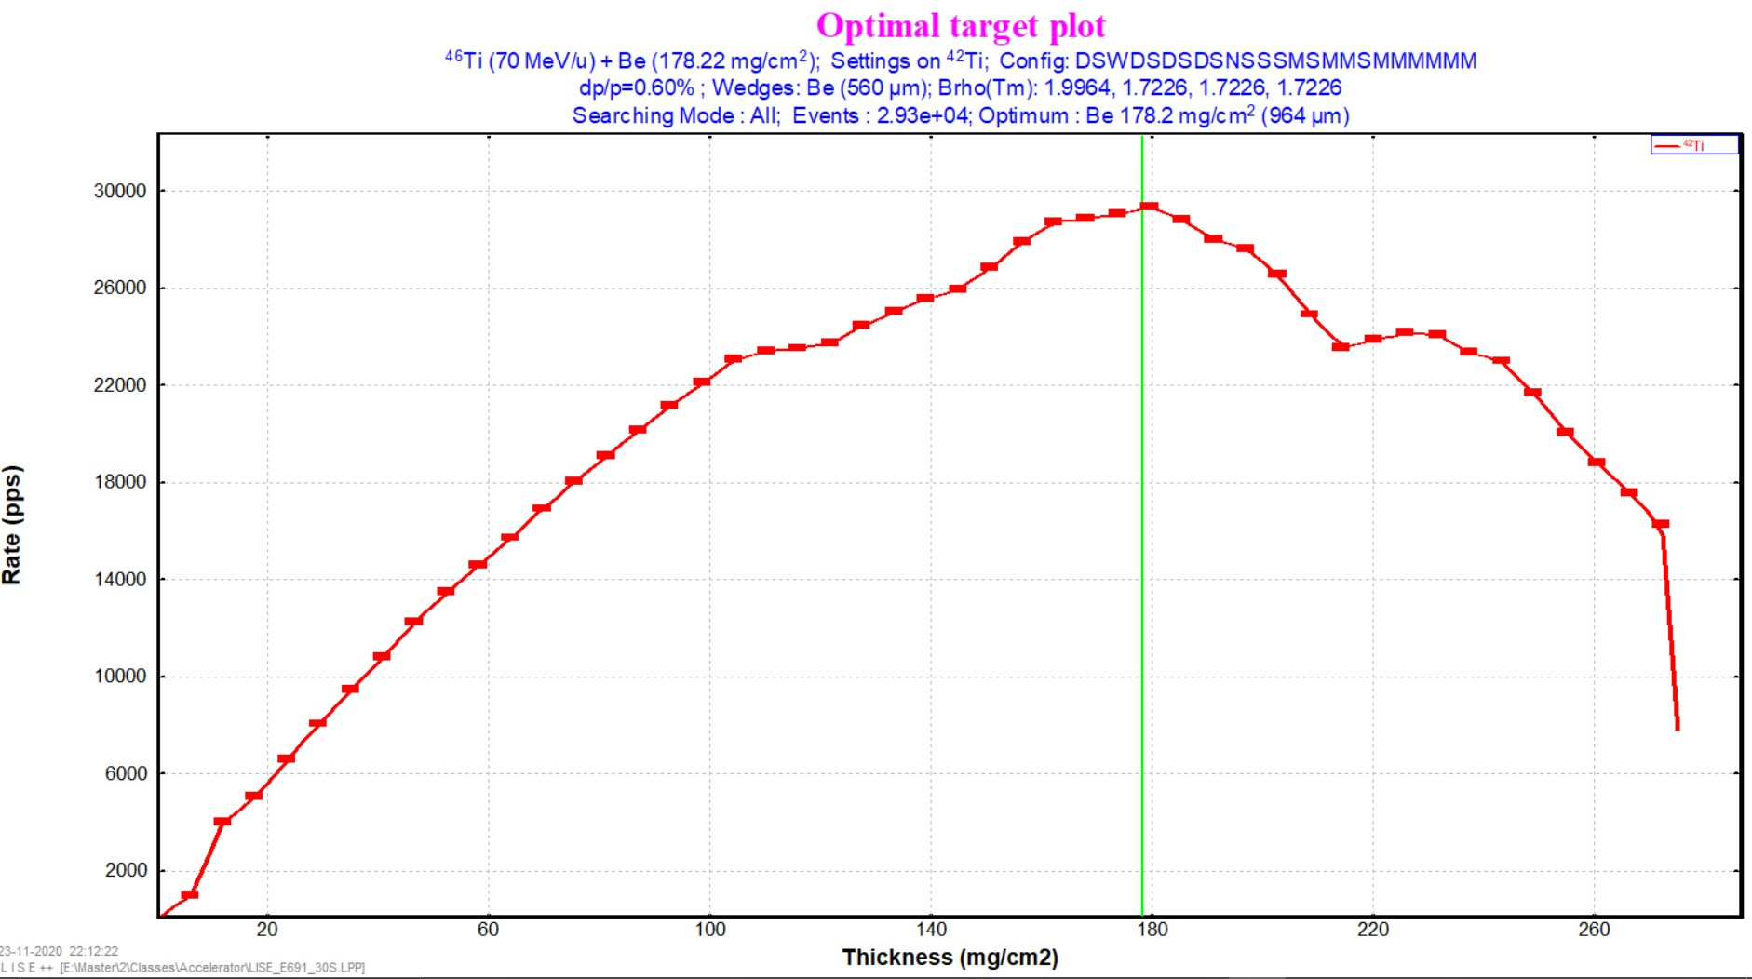
Target Thickness

Slide 5
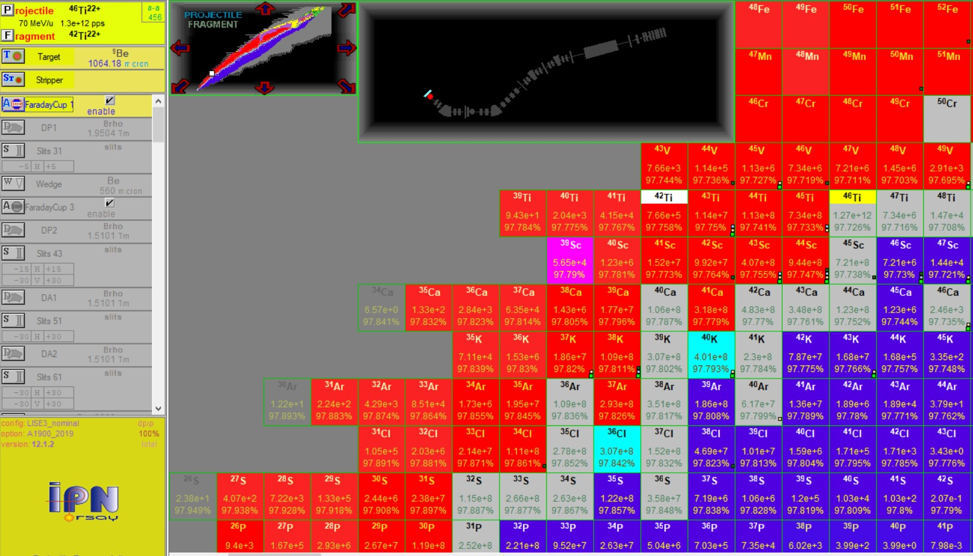
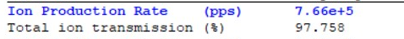
Nuclei Production After the Fragmentation
42Ti

Slide 6
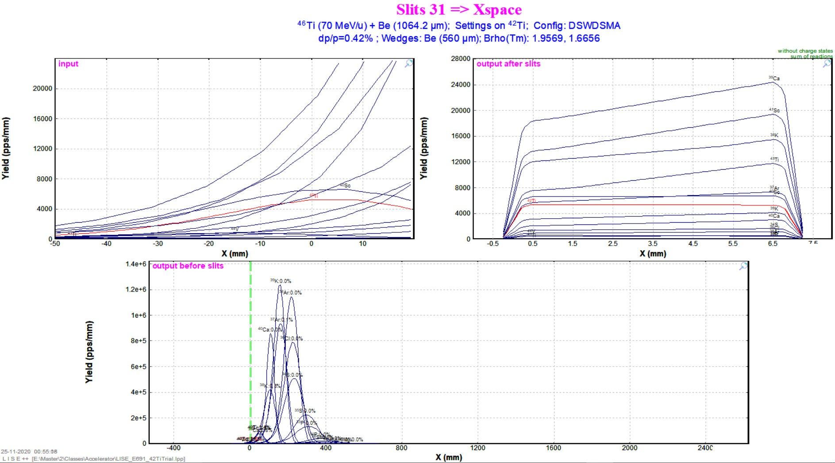
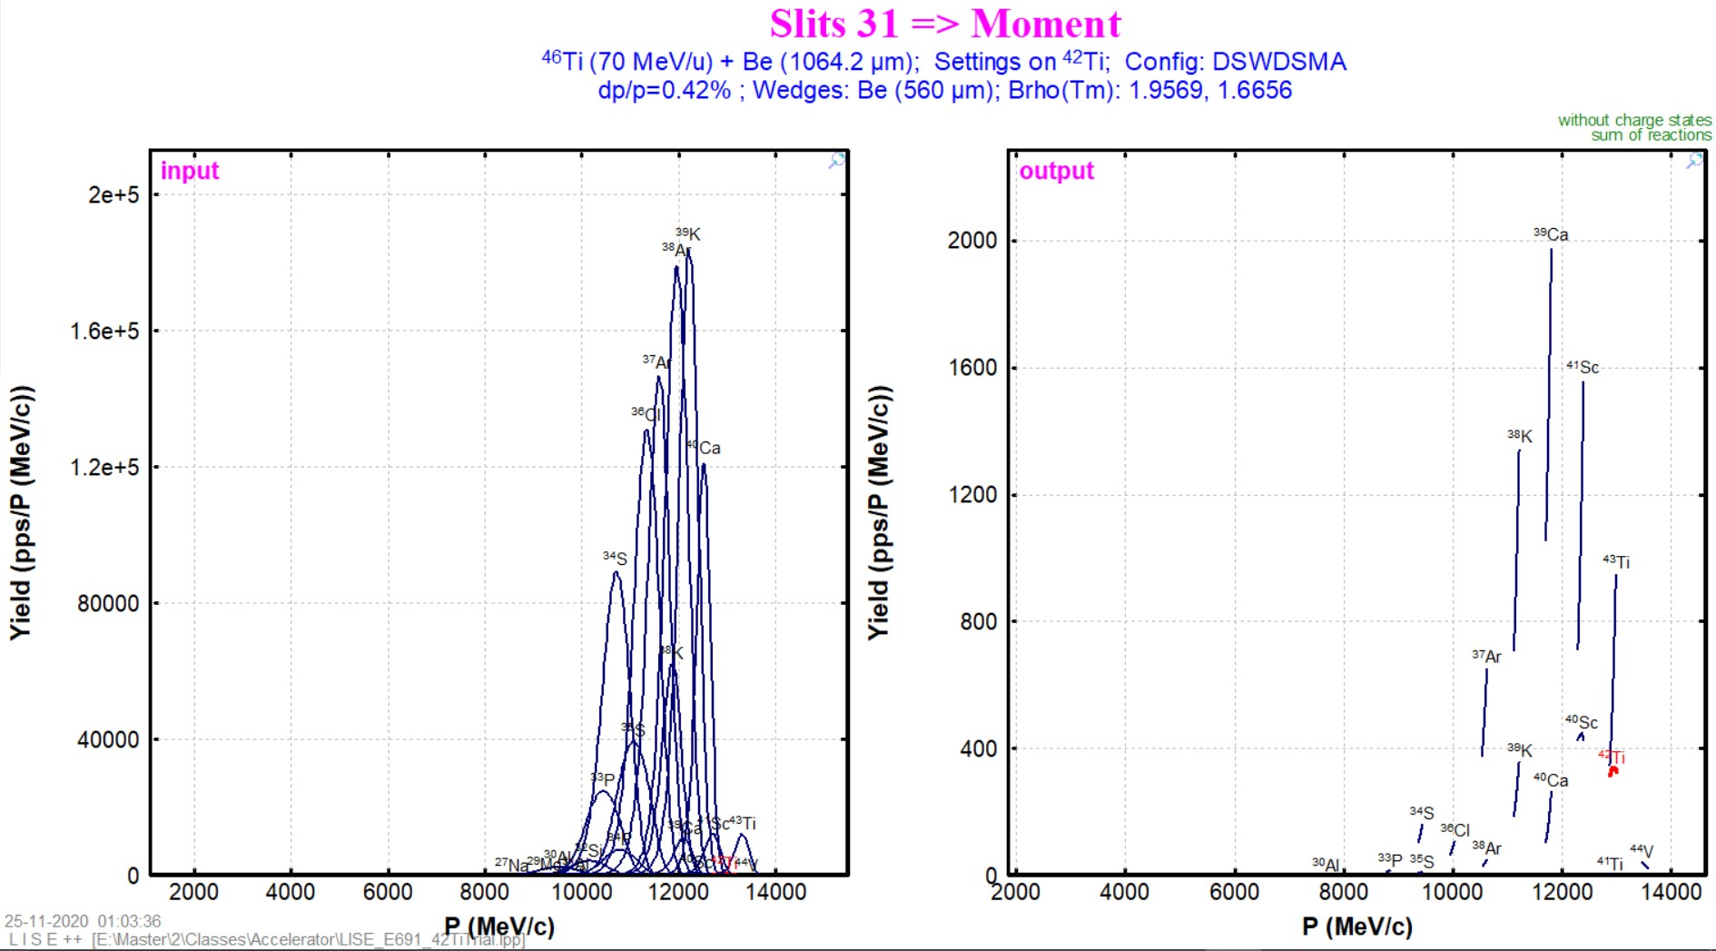
Effect of Slits
S31 = 0 _ + 7mm
Momentum Distribution
Production of ⁴²Ti = 3.72e+4 pps

Slide 7
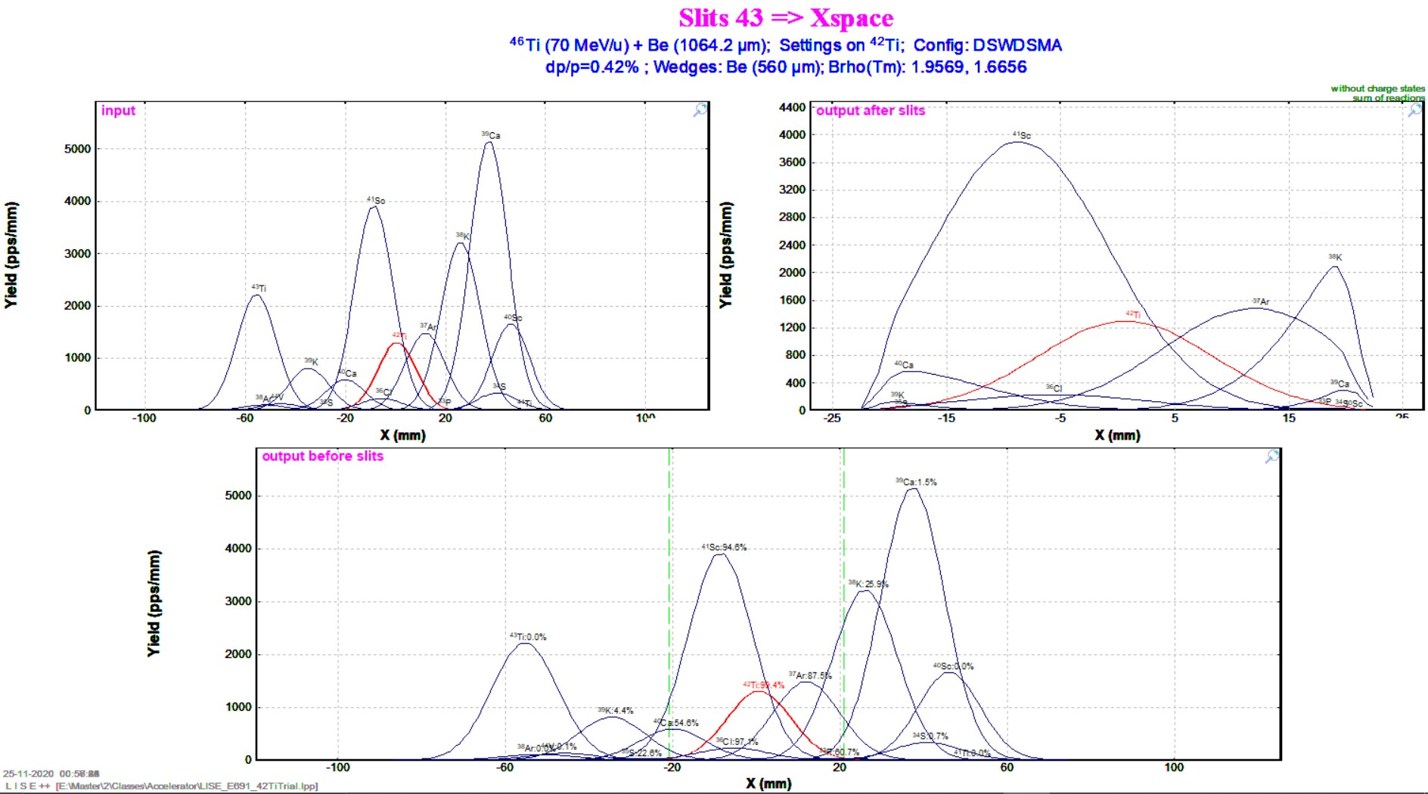
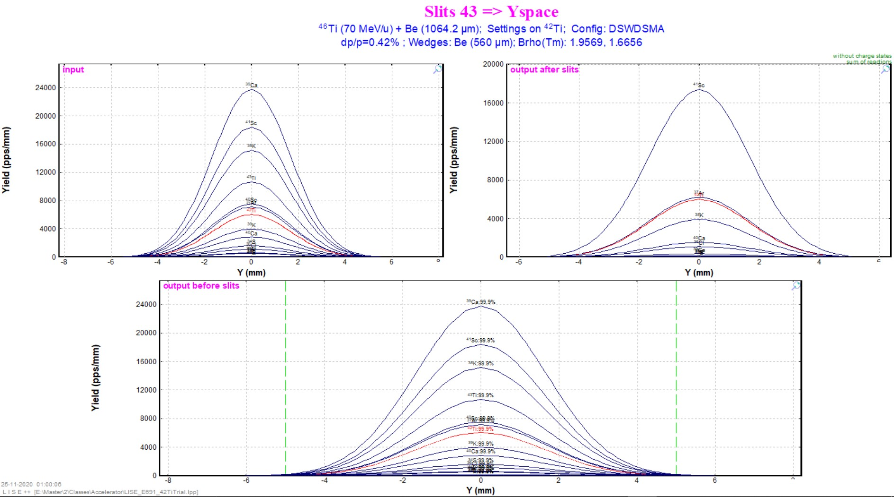
Effect of Slits
S43H = -21mm _ + 21mm
S43V = -5 _ + 5mm
Production of ⁴²Ti = 2.74e+4 pps

Slide 8
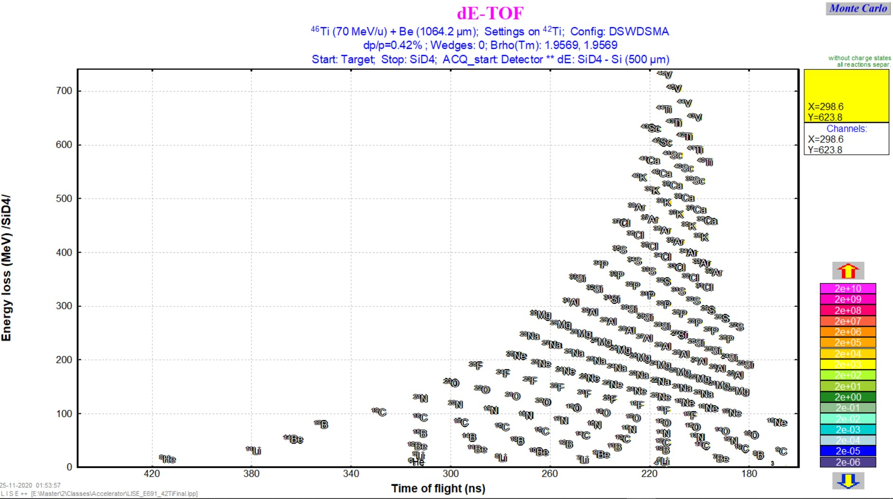
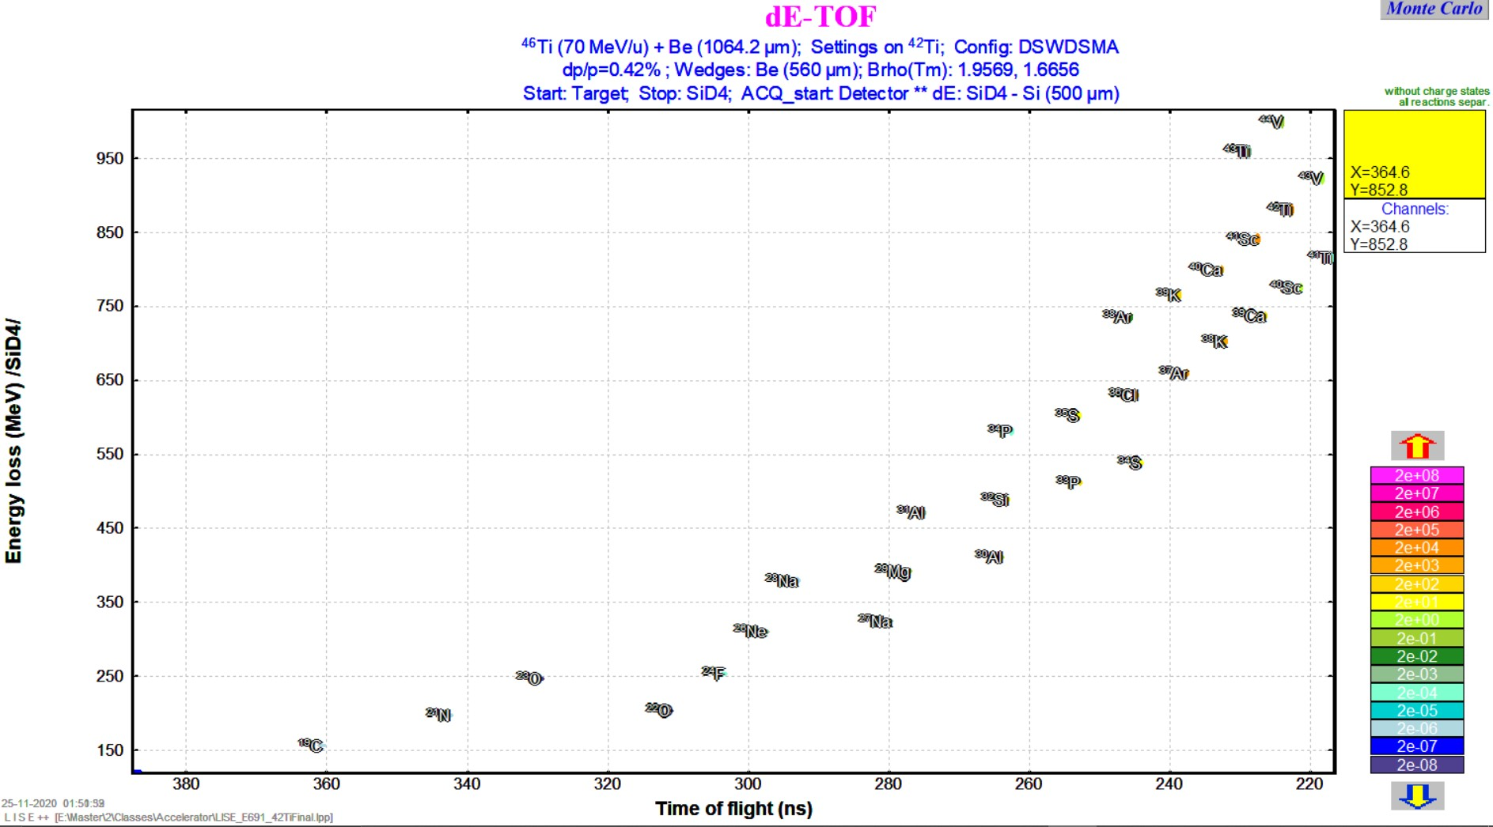
Effect of Be Wedge
Fragment Identification
Be Wedge = 0
Be Wedge = 560μm
Production of ⁴²Ti = 1.83e+4 pps

Slide 9
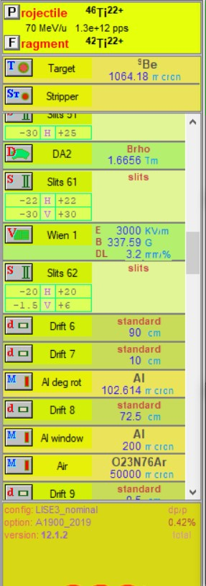
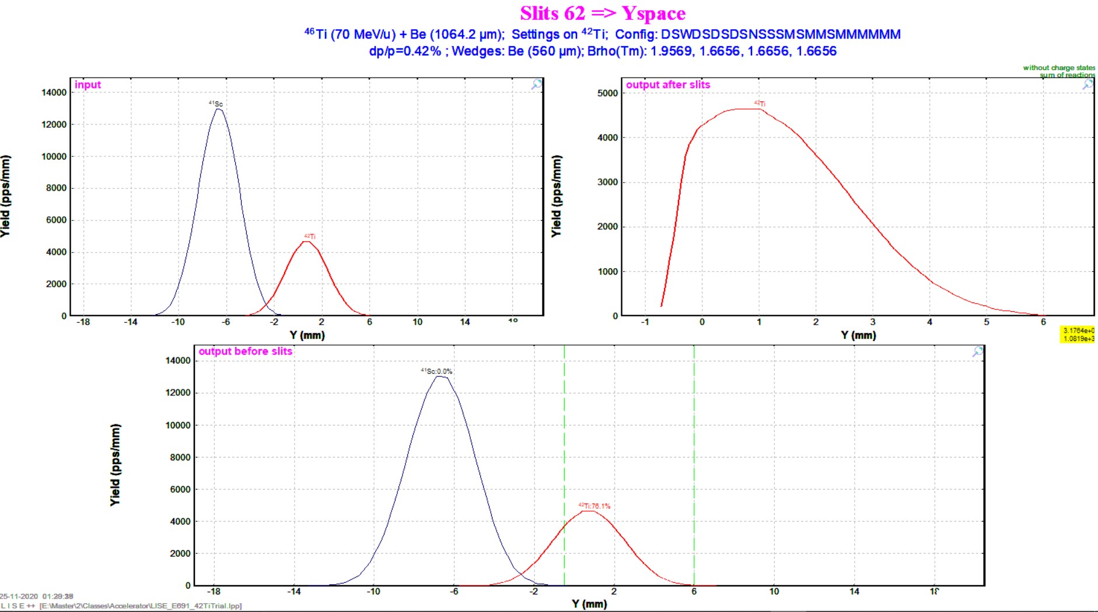
Effect of Wien Filter & Slits
E = 3000 kV/m
B = 337.59 G
Production of ⁴²Ti = 1.54e+4 pps
Wedge = 560μm
S62V = -1.5mm _ + 6mm & S61H = -22mm _ + 22mm & S51 = -30mm _+ 25mm

Slide 10
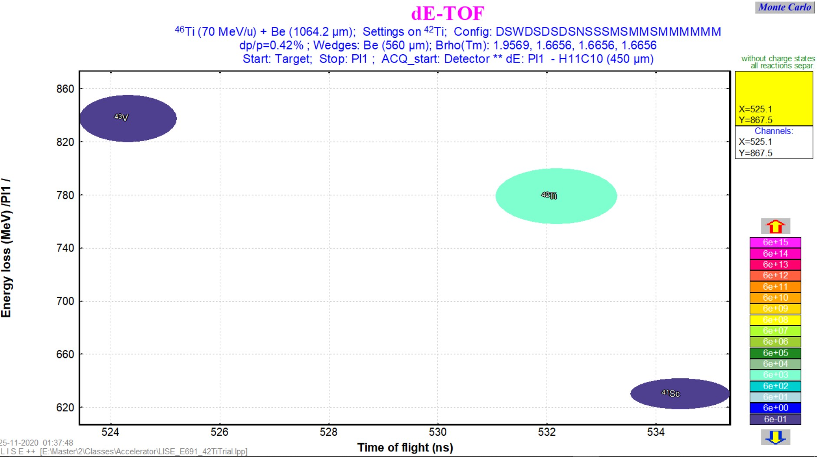
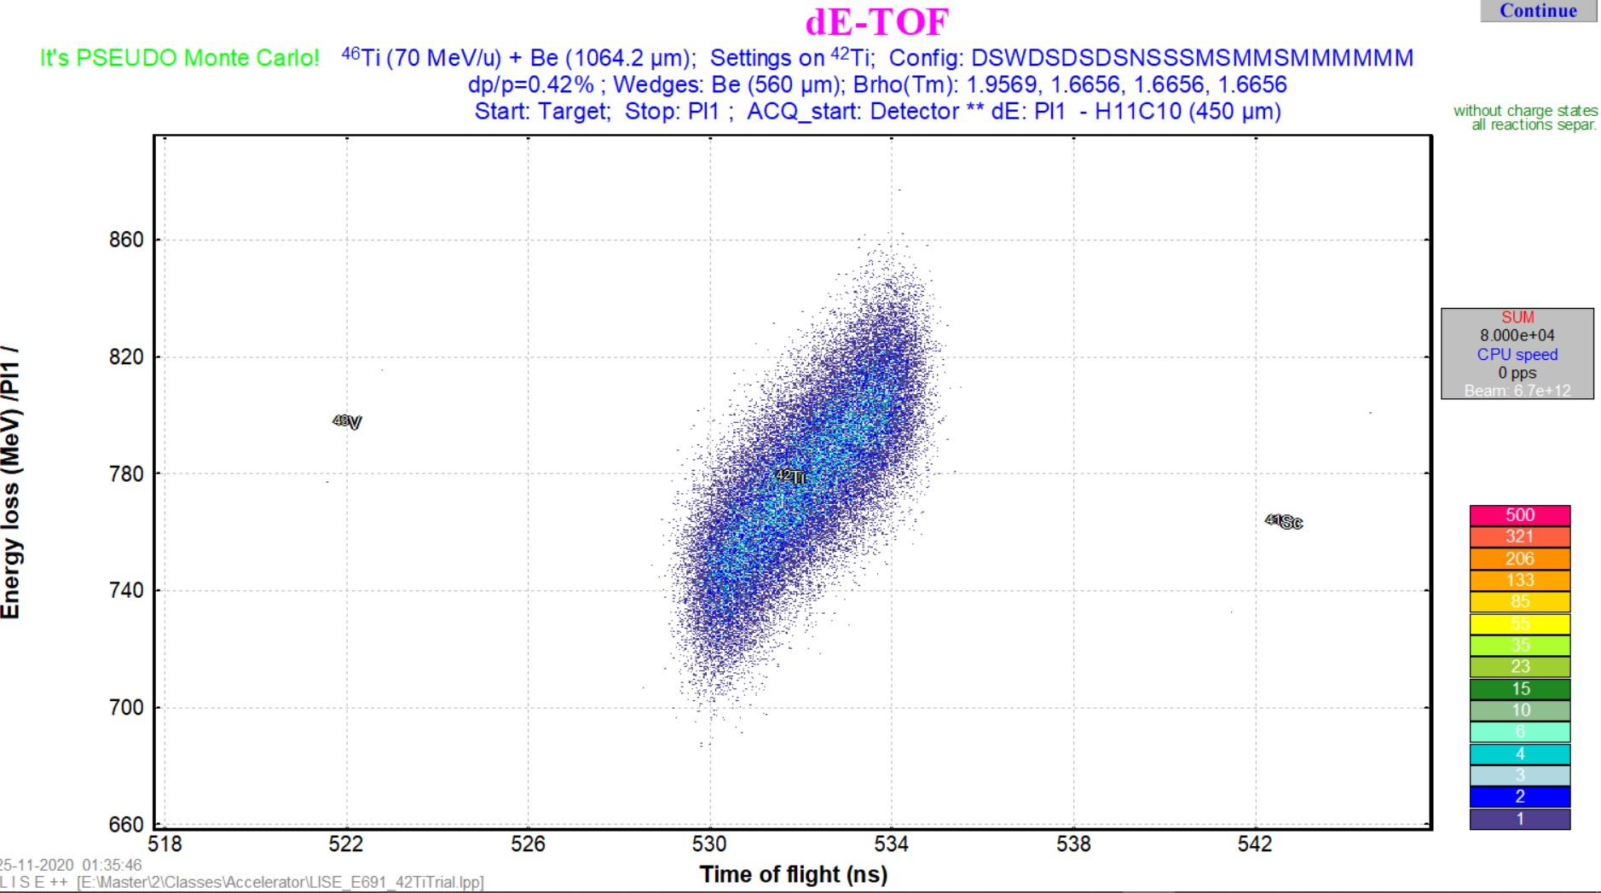
ΔΕ – TOF Fragment Identification
Calculated Distribution
Monte Carlo Simulation
Production of ⁴²Ti = 1.54e+4 pps
Production of impurity
43V = 0.715 pps & 41Sc = 0.91 pps

Slide 11
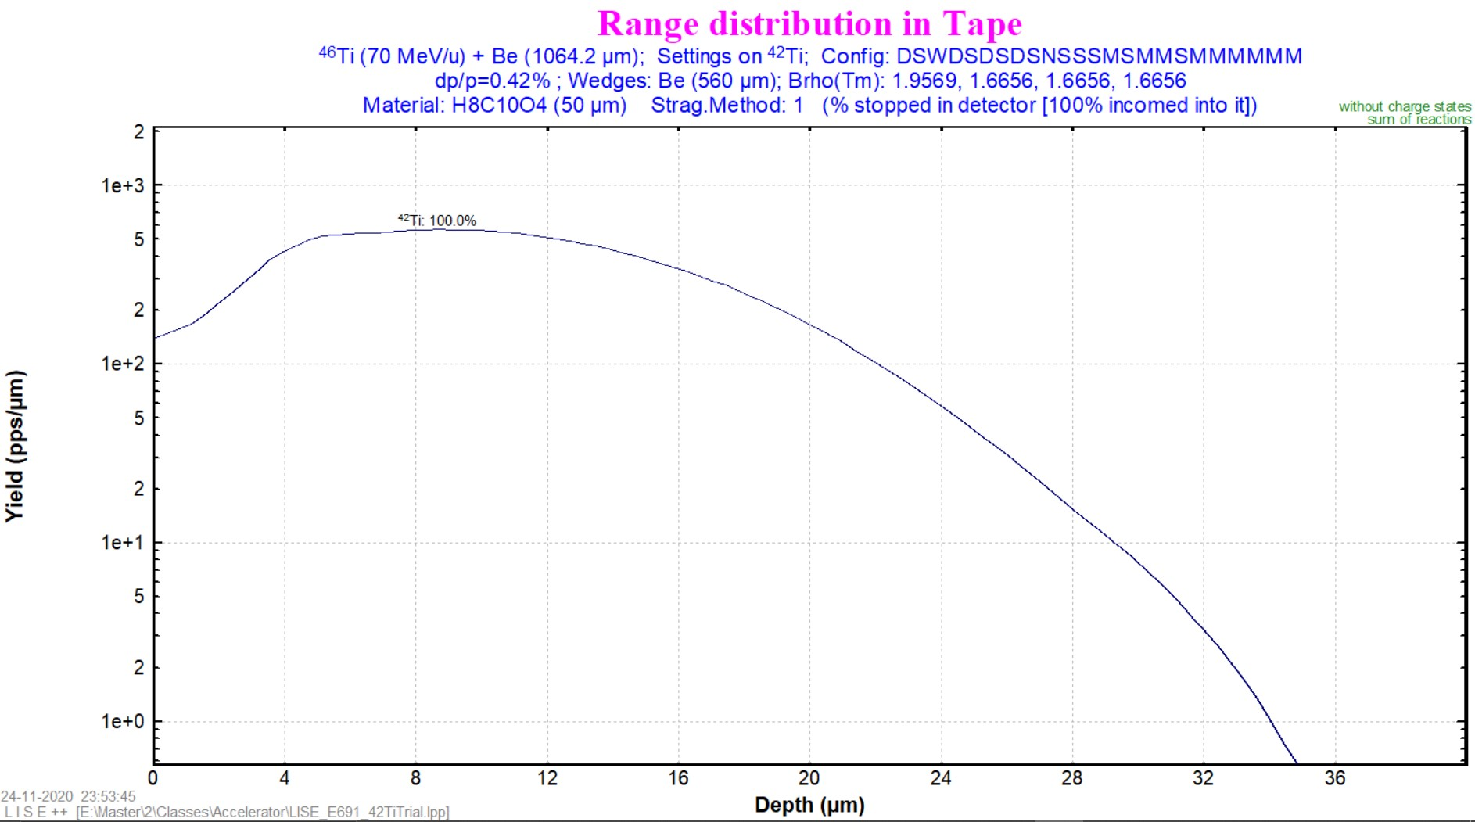
Ion Implantation in the Tape

Slide 12
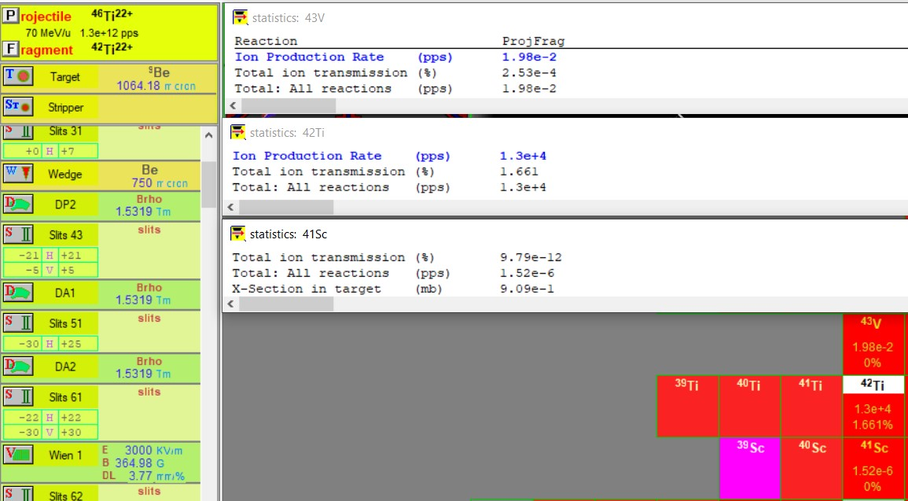
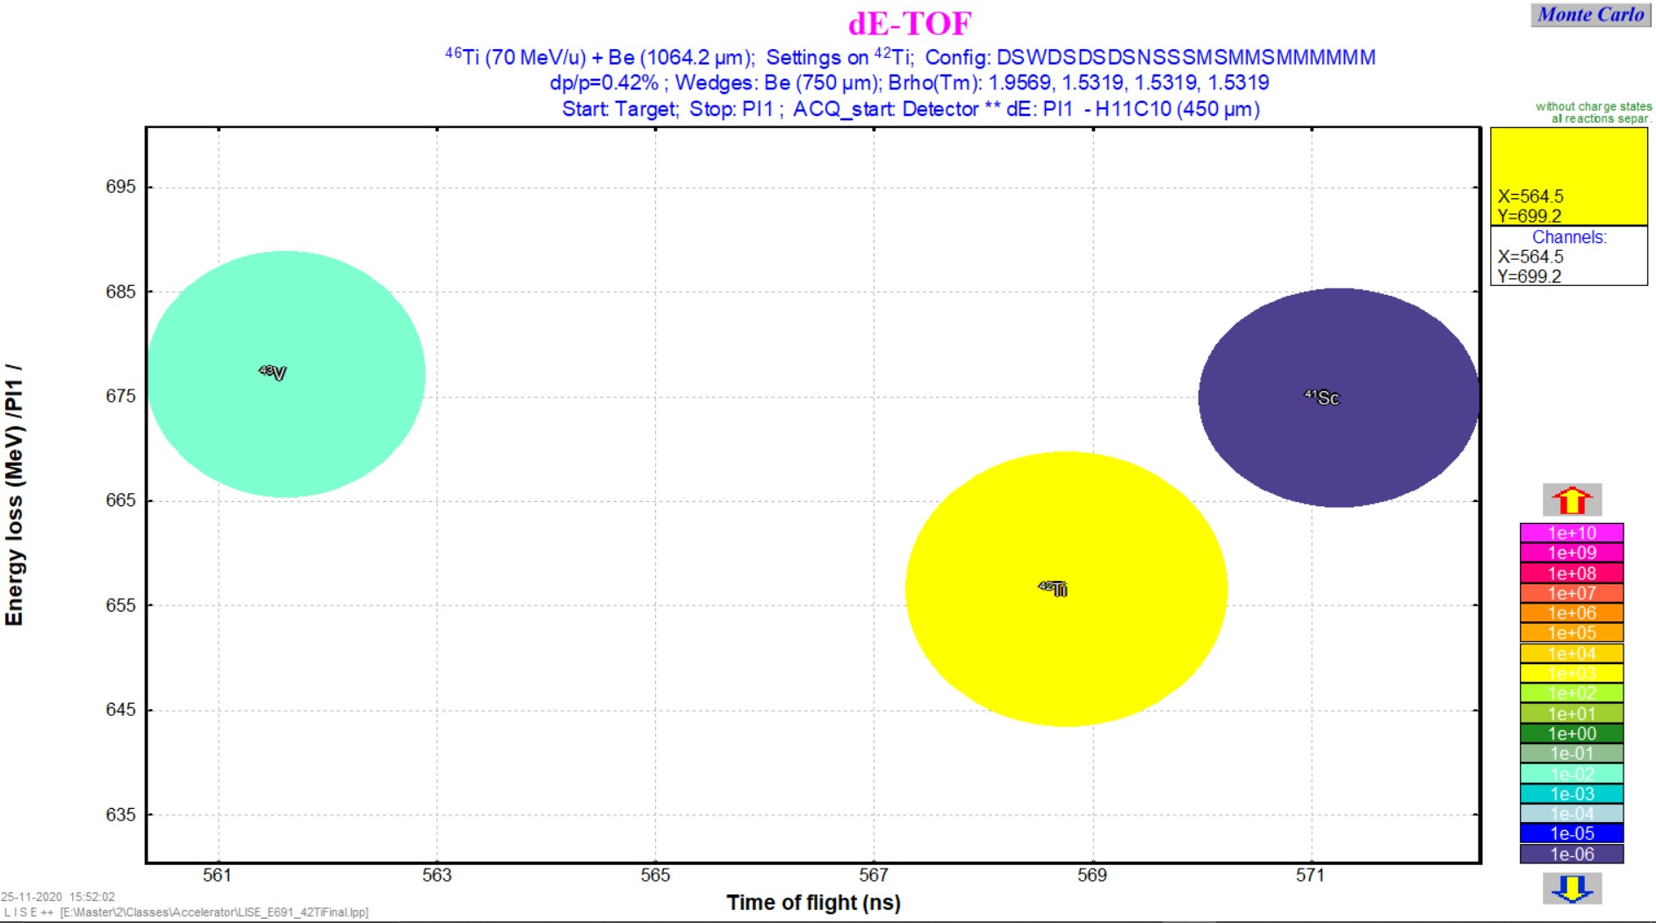
ΔΕ – TOF Fragment Identification
Wegde = 750 μm
Production of ⁴²Ti = 1.3e+4 pps
Production of impurity: 43V = 0.0198 pps & 41Sc = 9.79e-12 pps

Slide 13
Conclusion for Lise Spectrometer and Lise++
The purified beam can help for studies of super allowed transitions
Implantation at optimised depth

